Slide 1

SAE Cybersecurity Standards Activity
ETI ToolTech 2017
New Orleans, LA
April 27, 2017

Slide 2
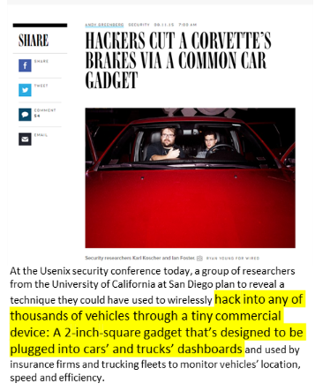



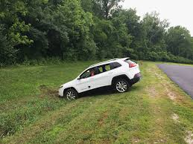
Car Hacking in the News…

Slide 3
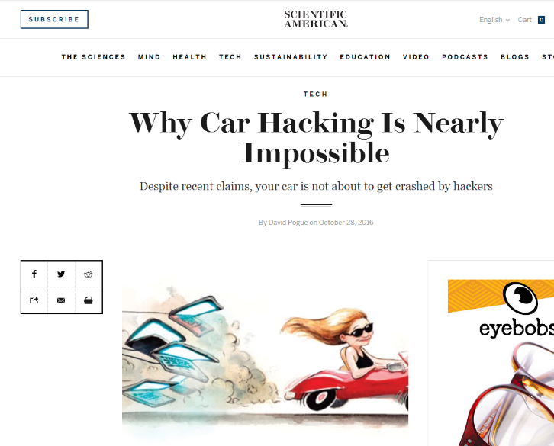

But The Good News…

Slide 4

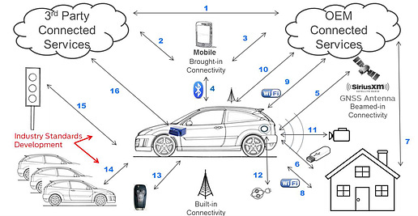
The Automobile is an Incredibly Complex Environment

Slide 5
SAE Publishes the World’s First Automotive Cybersecurity Standard
J3061 Cybersecurity Guidebook for Cyber-Physical Automotive Systems
    Published January 2016; drive to a risk-based, process-driven approach to address the Cybersecurity threats the automotive environment is experiencing.
    Provides guidance on how to integrate cybersecurity into their product development life-cycle
    Establishes the desired relationships between cybersecurity and safety
J3061 provides a foundation for further security standards development and is the “go-to” resource throughout industry

Slide 6
SAE Vehicle Cybersecurity Portfolio WIPs
J3061-1 Automotive Cybersecurity Integrity Levels
Develops an objective cybersecurity classification scheme
J3061-2 Security Testing Methods
Provides a detailed breakdown of currently available software and hardware security testing methods.
J3061-3 Security Testing Tools
This document serves as an agnostic list of manufacturers of security related tools and their capabilities.
J3101 Requirements for Hardware-Protected Security for Ground Vehicle Applications
Defines a common set of requirements for security to be implemented in hardware for ground vehicles to facilitate security enhanced applications and hardware protection for ground vehicle applications
6

Slide 7
SAE-ISO Automotive Cybersecurity Engineering Joint Work Group
SAE-ISO Automotive Cybersecurity Engineering JWG Committee
Co-Convenors: Lisa Boran, Ford, SAE
Gido-Scharfenberger-Fabian, Carmeq, ISO
Risk Management Project Team
Product Development Project Team
Operations Maintenance and Other Processes Project Team
Process Overview and Inter-dependencies Project Team
JWG Participation from:
11 ISO Nations
11 SAE experts
Over 100 Project Team Participants from :
10 OEMs
11 major suppliers
Dozens of consultants, security firms, and other suppliers

Slide 8
SAE Cybersecurity Activities
J3061 is becoming a “go-to” resource for many SAE Committees in different discipline areas, e.g.
On-Road Automated Driving Committee
Vehicle Electrical and Electronics Diagnostics Committee
Truck and Bus Controls and Communications Network Committee
New Data Link Connector Vehicle Security Committee
8

Slide 9
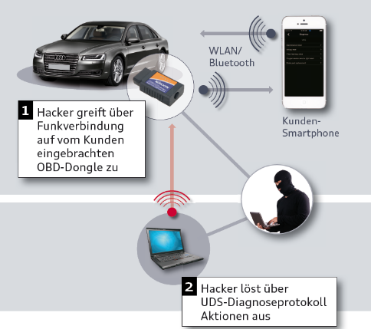
Acute Focus on OBDII Security
scenario
hacker attack over the mobile communication to the OBD dongle
September 12: Letter from House Committee on Energy and Commerce to NHTSA RE: OBD-II Security
  “…request that NHTA convene an industry-wide effort to develop a plan of action for addressing the risk posed by the existence of the OBD-II port in the modern vehicle ecosystem.”
hacker attack
hacker starts critical functions over the
UDS protocol
Courtesy of Bob Gruszczynski, Volkswagen: SAE September OBD Symposium September 2016

Slide 10

SAE Convenes Industry to Address OBD-II Security
SAE hosted invitation-only industry workshops December 1, 2016 and January 30, 2017.
Goals:
      Identify common issues, needs, and approach to secure the OBD
      Gain buy-in to development of an accelerated standards approach
      Launch a new Standard
    Very well-attended by industry
      Leads: Mark Zachos, DGTech and Bob Gruszczynski, VW
      OEMS, Light Vehicle Suppliers, Heavy Manufacturers and Suppliers, and Auto-ISAC
      Associations: MEMA, ETI, AutoCare Association
      Government/Regulators: CARB, NHTSA, NIST

Slide 11
New Data Link Connector Vehicle Security Committee
New Standard Work Item: J3138- Guidance for Securing the Data Link Connector (DLC)
Goal: This document provides guidelines for securing communications with any off-board device for vehicles.
Scope: The Data Link Connector supports communication of diagnostic information to off-board devices as well as legislated diagnostic information. This standard is focused on the securing the DLC in Vehicle network environments including:
      Open access to communication busses
      Communication busses isolated via a gateway
      Any “hybrid” approaches

Slide 12
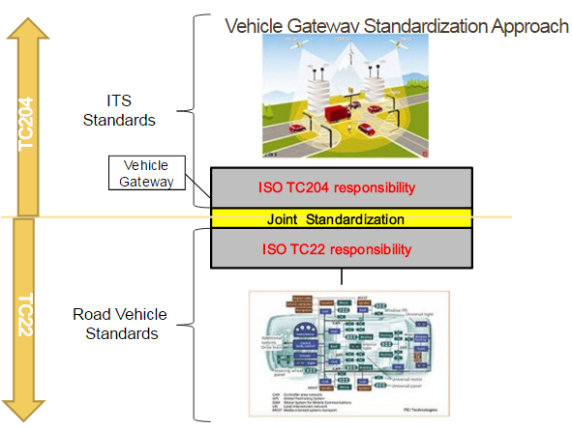
Data Link Connector Vehicle Security Committee: New Work Item
Vehicle Interface Security Information Report
Rationale: Other standards projects, mostly in ISO TC22 and TC204, aimed at securing the totality of interface to the vehicle (h/w and s/w interfaces). We want to learn from other activities and integrate as we can into future SAE Standards (and potentially joint standards with ISO).
Proposed Scope: Provide an overview of some current practices which could be utilized for securing the vehicle’s interfaces from cybersecurity risks
Samples:
ISO Extended vehicle methodology (ExVe)
  ISO Vehicle Station Gateway (VSG)
  ISO Secure Vehicle Interface (SVI)

Slide 13



Other Cybersecurity Collaborations
Working with NIST to examine Assurance testing for cybersecurity using NIST Cyber-Physical System Framework and Federated Test Bed Software testing suite
Early collaboration with UN Economic Commission for Europe (UNECE) Working Party 29 Task Force on Automotive Cybersecurity and Over-The-Air Updates

Slide 14
Contact:
Tim Weisenberger
Tim.Weisenberger@sae.org
Ph: 248.840.2106

