Slide 1
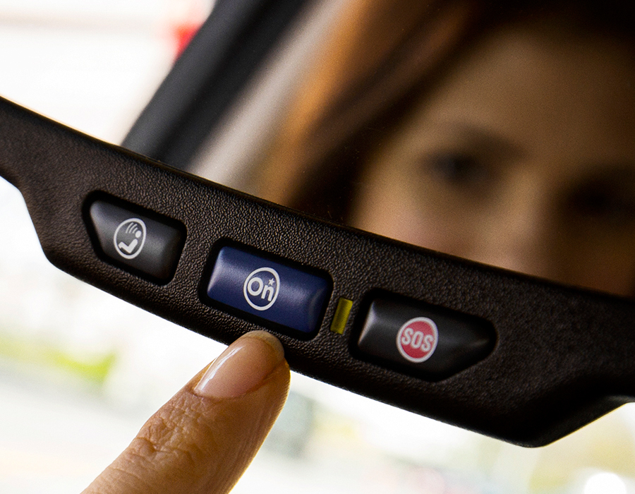
GM Global Connected Customer Experience and OnStar

Slide 2
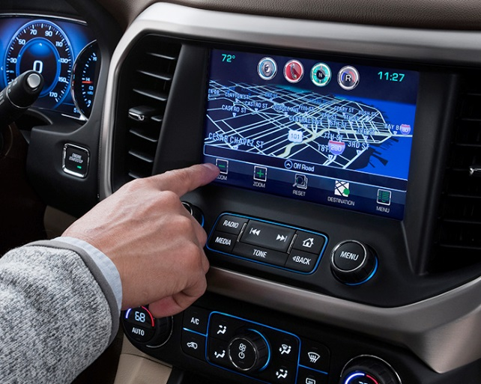
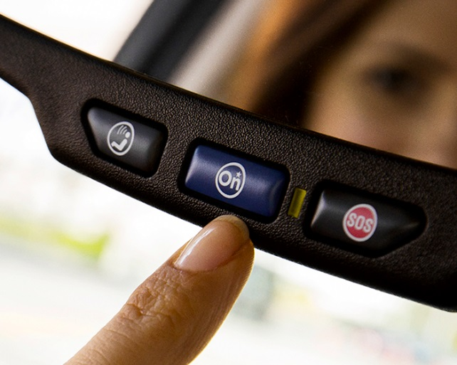
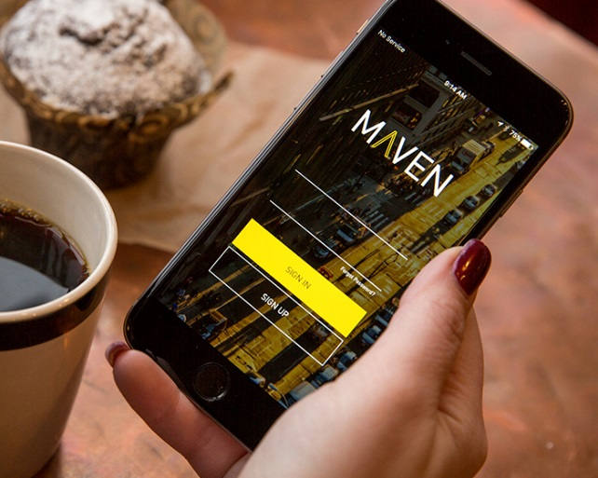
OUR MISSION
WE CONNECT CUSTOMERS TO RE-IMAGINED MOBILITY EXPERIENCES THAT PEOPLE LOVE
CONNECTED CARS
ONSTAR
CUSTOMER EXPERIENCE
URBAN MOBILITY
Bringing your digital life to the car
20 years of connecting customers
From Transactions to Relationships
Increasing Share of Miles

Slide 3
THE ONSTAR INFRASTRUCTURE
1
GPS Satellites
4
Cell Towers
6
OnStar Contact Centers
5
OnStar Data Center
8
Emergency Services
2
GPS Receiver
3
OnStar Three- Button Interface
7
Advisors
Average Time Call Response
OnStar Command Center
Automatic Crash Response or Push Button
1 sec
15 sec
30 sec
Engage First Responder

Slide 4
GLOBAL CONNECTED VEHICLE SERVICES
12 MILLION
CUSTOMERS
U.S., Canada, Mexico, China, Europe and South America

Slide 5
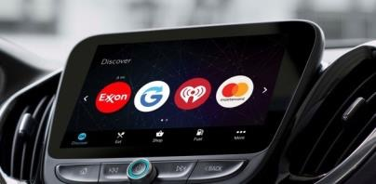
ADDING VALUE TO MOBILITY EXPERIENCE
CONNECTING YOU TO YOUR FAVORITE BRANDS AND GIVING YOU TIME BACK
DRIVING TIPS VIA OnStar Smart Driver & POTENTIAL INSURANCE DISCOUNTS

Slide 6
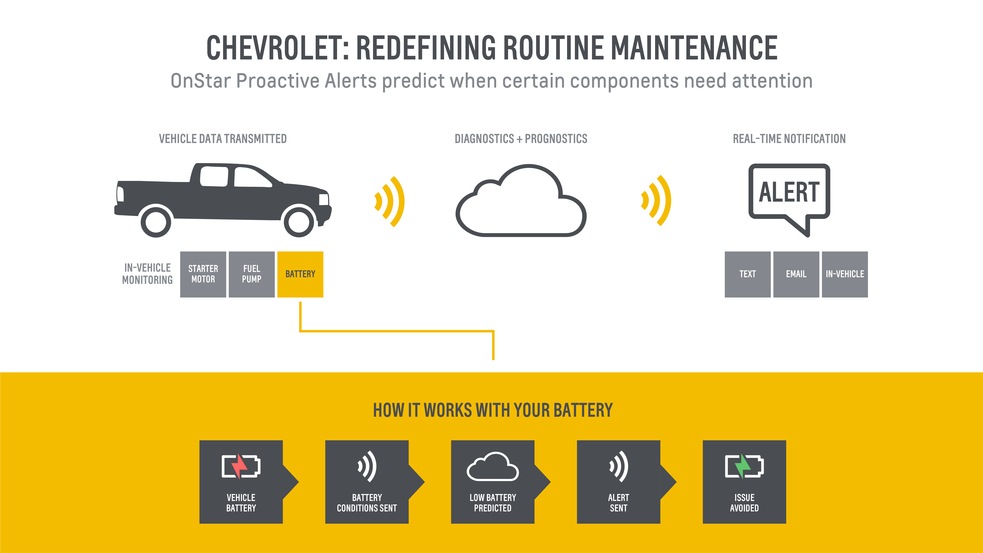
KEEPING CUSTOMERS CONNECTED TO THEIR VEHICLE
PROACTIVE
>7 MILLION DIAGNOSTICS REPORT EMAILS SENT EVERY MONTH
ALERTS
ONE STEP AHEAD OF MAINTENANCE ISSUES

Slide 7
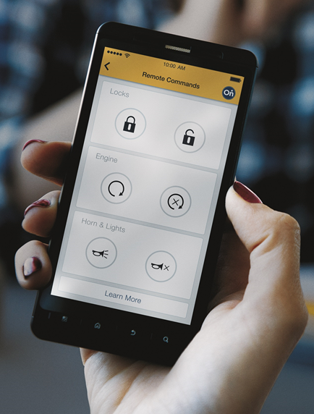
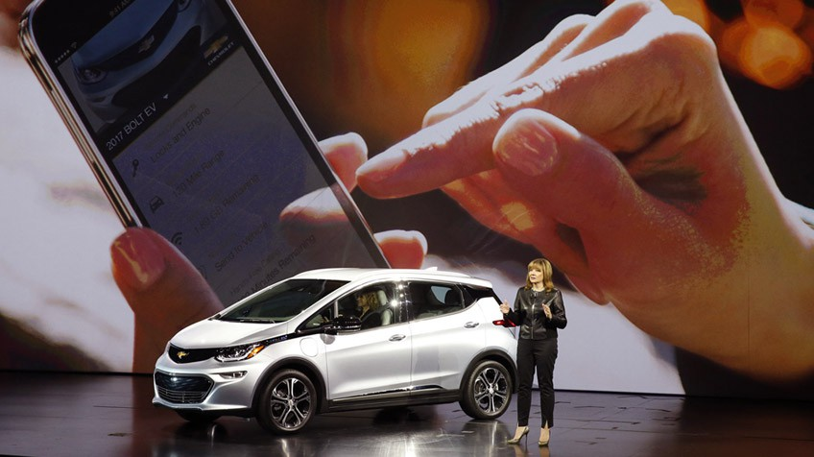
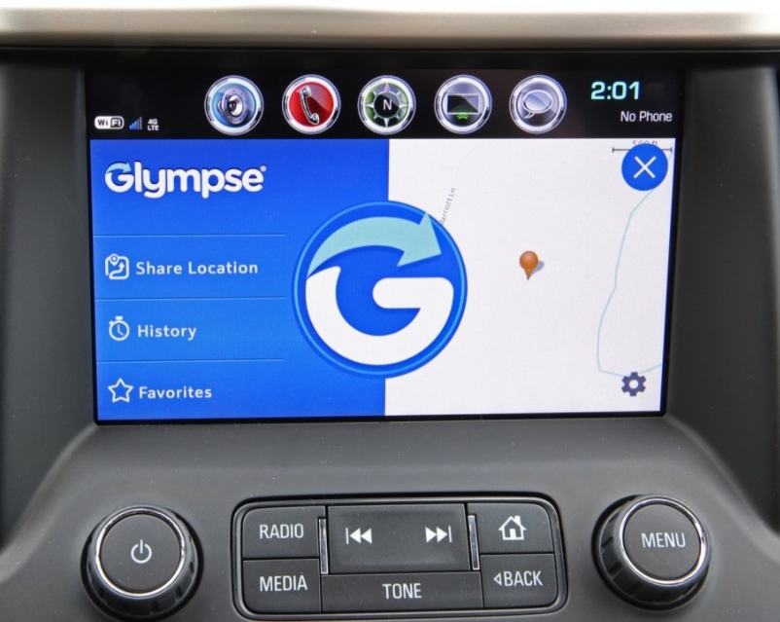
CONNECTED APP EXPERIENCE
225 MILLION
MOBILE
INTERACTIONS in 2016
LEADERS IN PHONE PROJECTION & COMPANION APP CAPABILITY
PROPRIETARY
IN-VEHICLE APP FRAMEWORK

