Slide 1
Connected Car Panel Tool Tech 2017 April 27, 2017

Slide 2
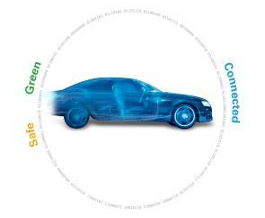
Convergence of Safe, Green & Connected
A safer ride
Increasing regulation
Active Safety
Automated Driving
Power for functions
More stringent regulations
Engine systems
48V hybrid electrification
Connected car
Demand for IoT
Leveraging BYOD
Onboard navigation
Intelligent Driving

Slide 3
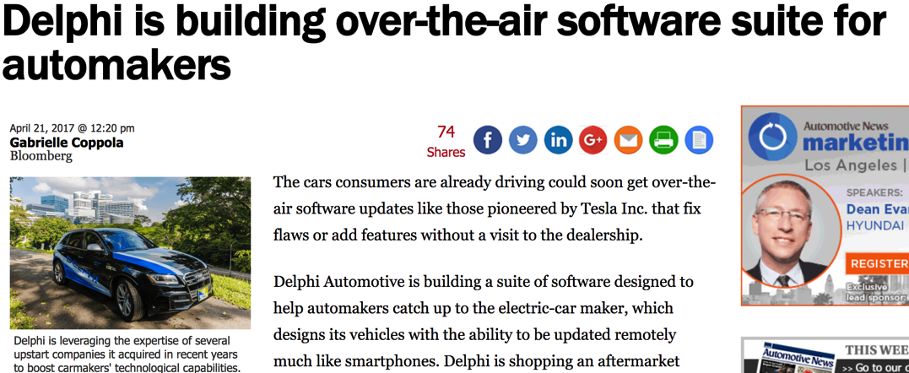
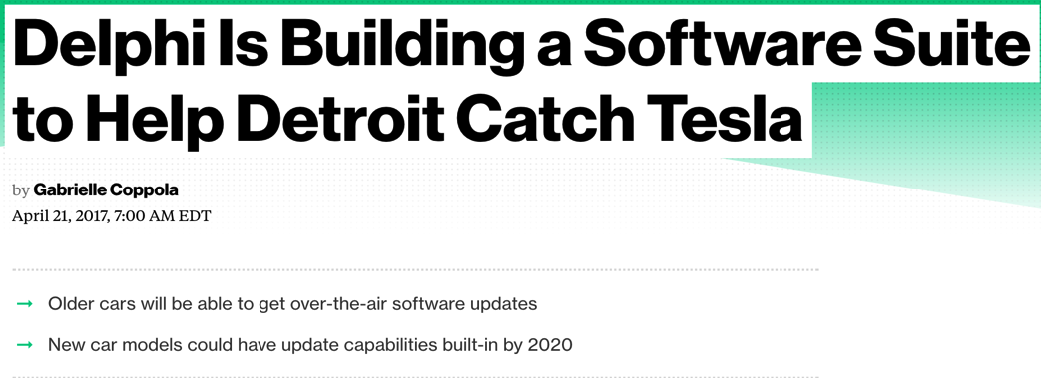
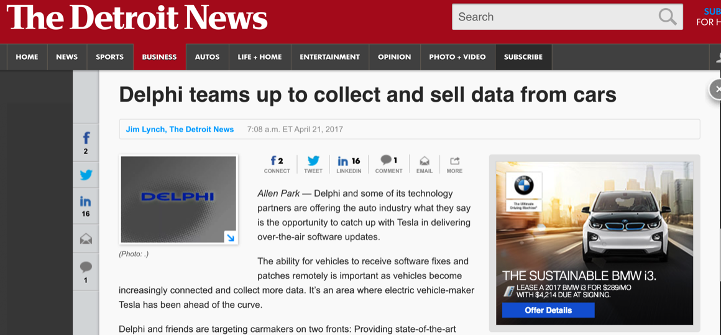
Connected Vehicle Investments

Slide 4
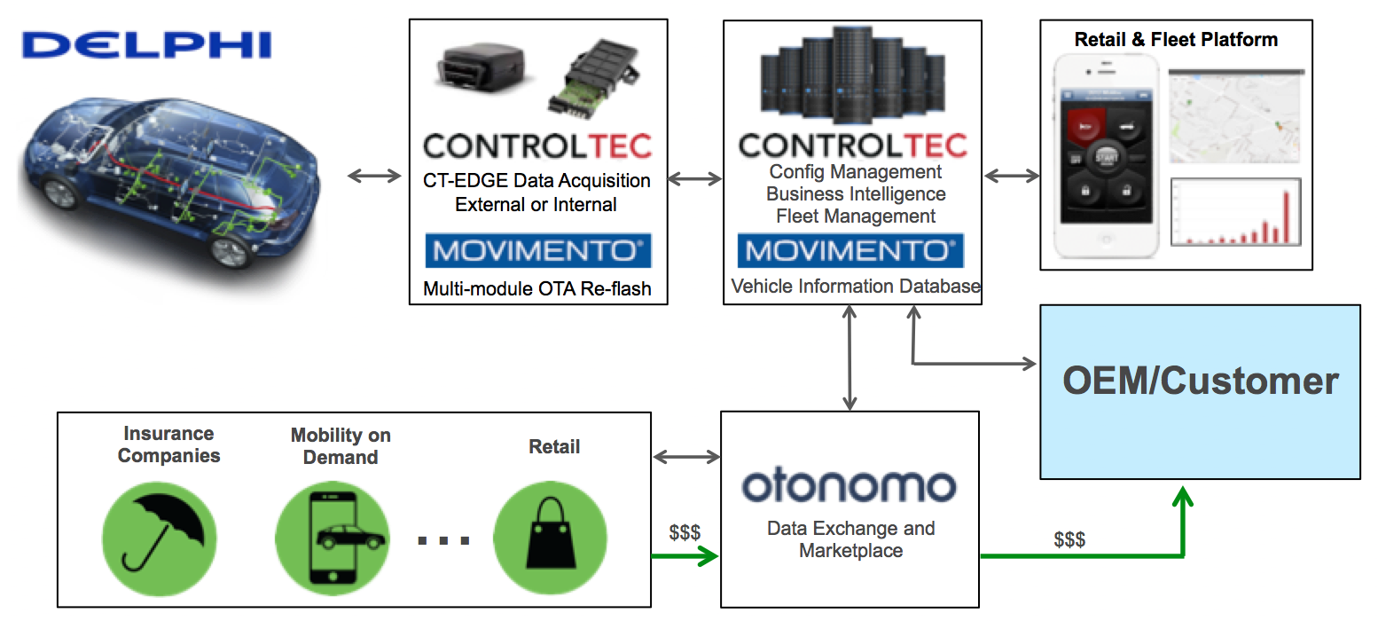
Delphi’s Connected Vehicle Platform

Slide 5
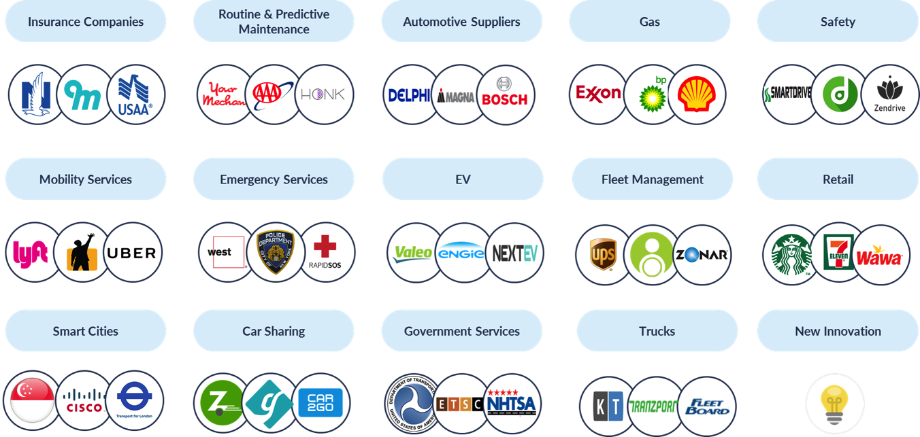
Demand for Vehicle Data
Recent McKinsey study values vehicle data up to $700/vehicle/year

Slide 6
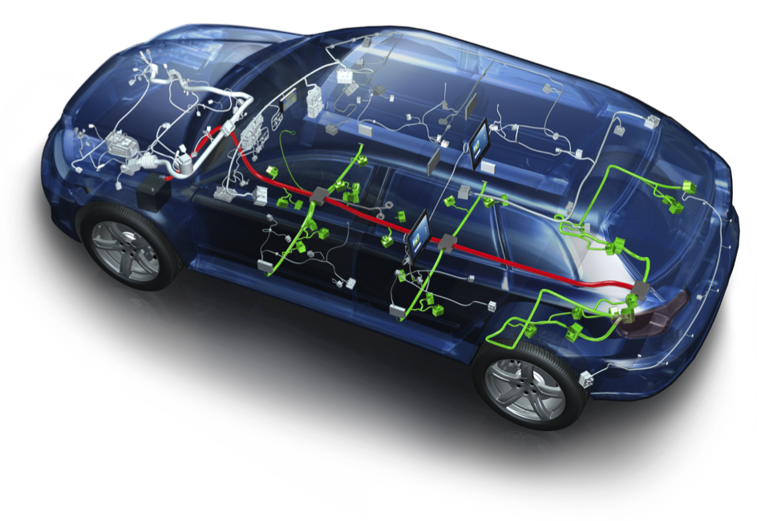
Benefits of Edge Computing
CT-EDGE
Complex systems require high speed, real-time data analysis to deliver meaningful insights
Stop data paralysis – deliver the needles, not the haystack
Reduced data payload
Surgical data acquisition enables scale
Increased data density enables full vehicle validation
Data challenge increasing with ADAS & Autonomous features
Maximize value of connected vehicles for 3rd party data market

Slide 7
Why Live on the Edge?
Customer Start Example:
1 Hz Data
100 Hz Data

Slide 8
Who Owns the Data?
Customer needs value to use third party data device:
Financial - Monetize their connectivity:
Usage Based Insurance (UBI)
Location Based Services (LBS)
Service incentives
Functional - Value added features:
Mobile WiFi hot spot
Remote key fob functionality
Driver monitoring – geofencing, speed alerts, etc.
Parking assist
Emergency services
Vehicle health monitoring
Predictive maintenance

Slide 9
Q&A
To discuss further, contact:
Bill Leisenring
bleisenring@control-tec.com

