Slide 1

Advanced Driver Assistance Systems Panel
Ted Ginnity, Hella
Kaleb Silver, Hunter
Craig Smith, Rapid7
Joshua Stone, Honda
Moderator - Robert Vogt, IOSiX

Slide 2
Overview of ADAS Systems

Slide 3
Video – Overview (Hella confidential)
This video is available on request from Hella Gutmann

Slide 4
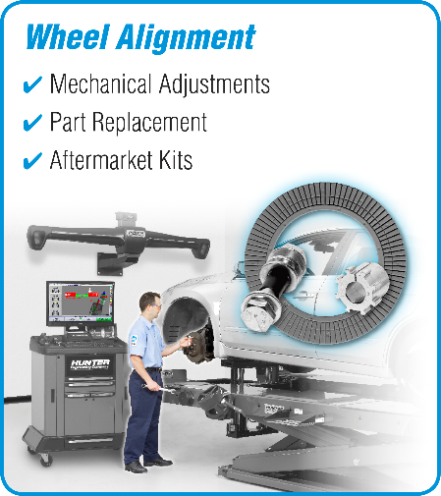
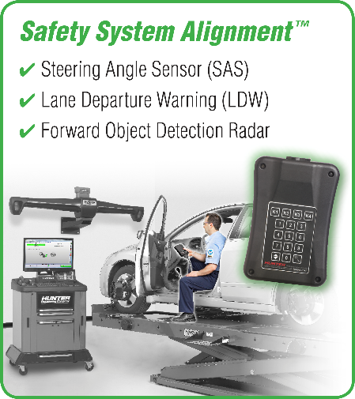

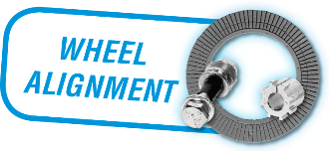
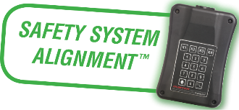
2 Types of Alignment
Wheel Alignment
Safety System Alignment
ESC
Electronic Stability Control (ESC)
  Standard on ALL cars since 2012
  Not all require reset
Electric Power Steering (EPS)
  Increasing Popularity for Hybrid & Stop/Start Vehicles
  Allows power assist steering without running power steering pump (hydraulic system)
Advanced Driver Assistance Systems (ADAS)
  Lane Departure Warning (LDW)
  Lane Keep Assist (LKA)
  Adaptive Cruise Control (ACC)
  Forward Collision Warning (FCW)
  Automatic Emergency Braking (AEB)
EPS
ADAS

Slide 5
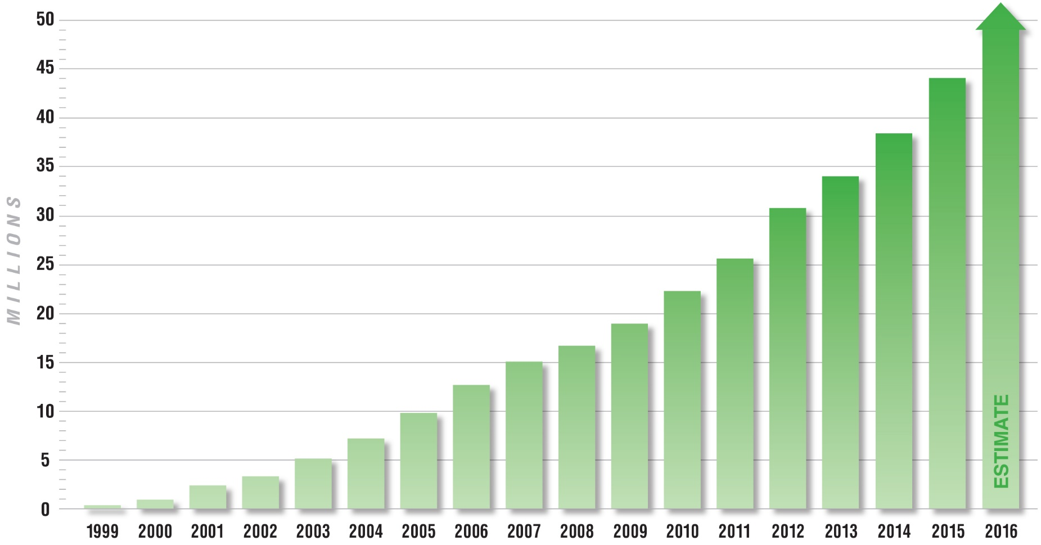
Over 50 Million Vehicles Require a Steering Angle Sensor Reset After Wheel Alignment

Slide 6
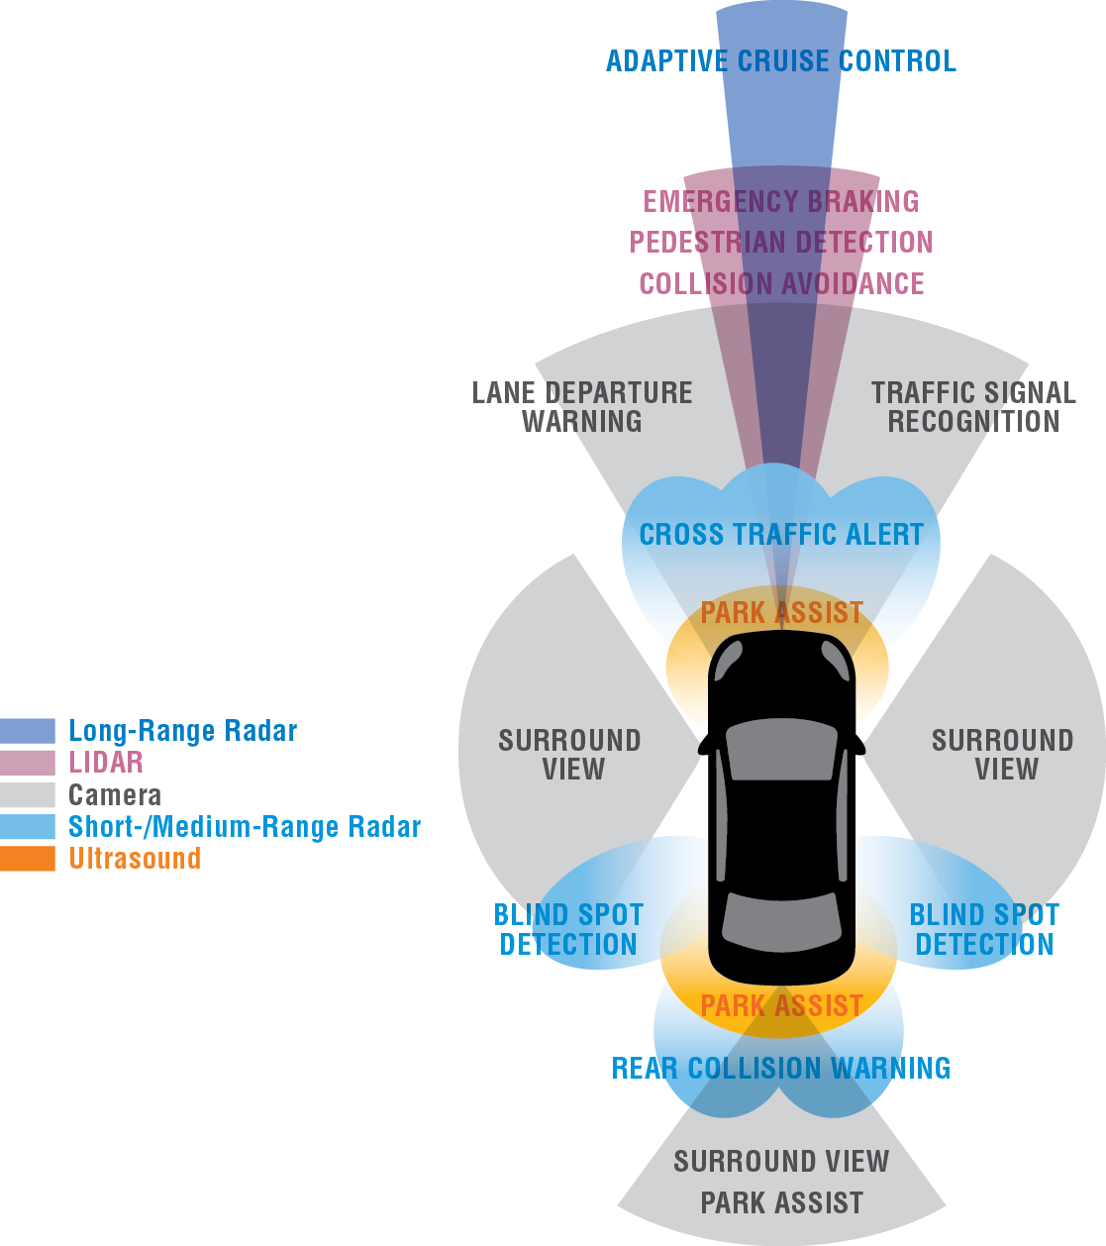
Safety System Alignment™ Overview
Many vehicles are now equipped with Advanced Driver Assistance Systems (ADAS)
Many require a reset:
  After wheel alignment
  Part replacement
  Windshield replacement
  Other changes to the direction of travel of the vehicle
Reset may involve a short drive

Slide 7
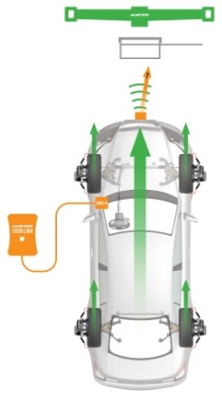
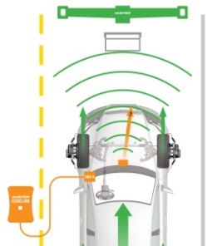
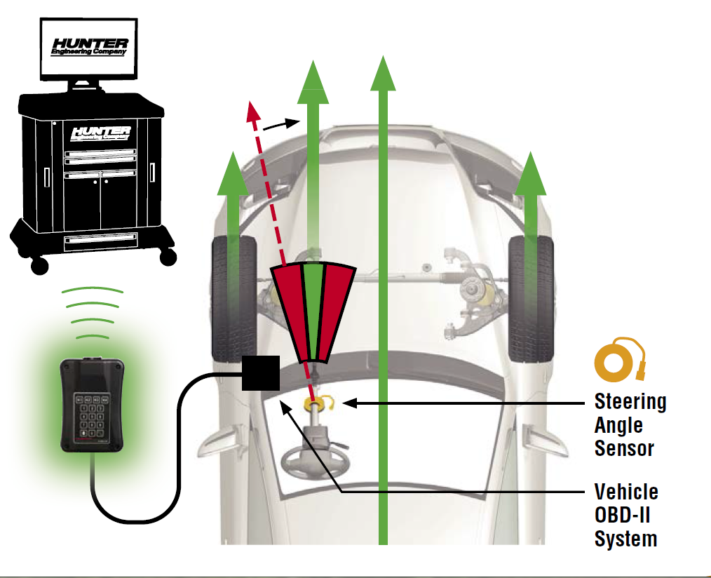
Why Is Safety System Alignment Important?
Adaptive Cruise Control & Forward Collision Warning
Electronic Stability Control
Lane Departure Warning
RADAR
CAMERA
Steering Angle Sensor
ALL reference direction of vehicle travel (Thrust Line)

Slide 8







Common Vehicles Requiring ADAS Reset After a Wheel Alignment Today
Radar Based Cruise Control
  Dodge – Charger, Challenger, Durango
  Chrysler – 200, 300
  Jeep – Cherokee, Grand Cherokee, Renegade
  Nissan – Altima, Rogue, Murano, Maxima
  Infiniti – JX35, QX60, QX80, Q50, Q70
Camera Based Lane Departure Warning
  Ford – Edge, Explorer, F-150, Focus, Fusion, Taurus, Transit
  Lincoln – MKC, MKS, MKT, MKX, MKZ

Slide 9

Video - Ford

Slide 10
Video - Chrysler

Slide 11
Video - Nissan

Slide 12
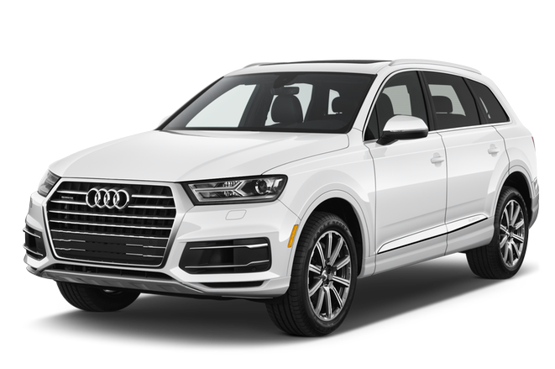
2017 Audi Q7 Possible Resets
System | Book Time
ESC | ?
ACC – Left Radar | 1.0
ACC – Right Radar | 1.0
Lane Departure Warning | 1.0
Night Vision System | 1.0
Rear Camera System | 1.0
Blind Spot Monitoring Left | 1.0
Blind Spot Monitoring Right | 1.0
Adaptive Front Lighting | 1.0
Top View Camera System | ?
Total | Over 8 Hours!

Slide 13
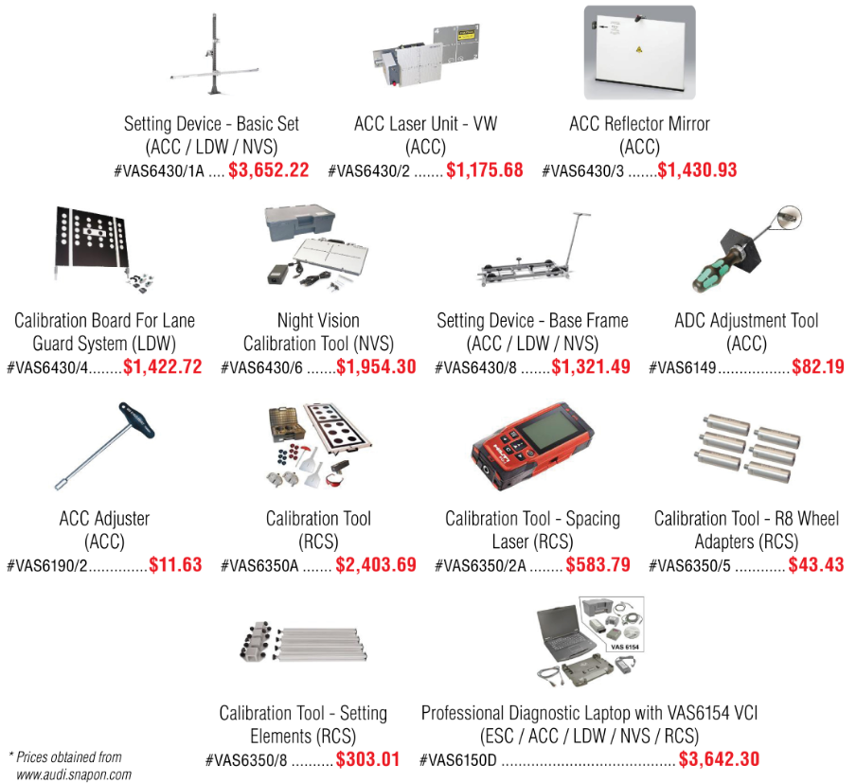
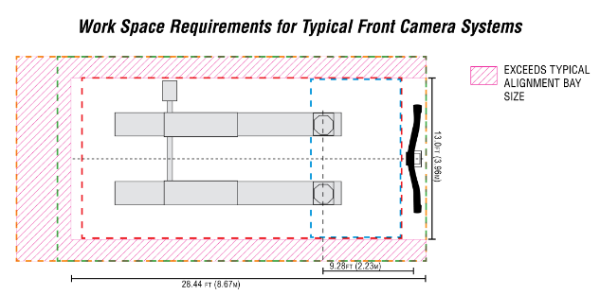
2017 Audi Q7 Required ADAS Tools:
Over $18,000 Additional Investment Required
+ Additional Bay Space

Slide 14
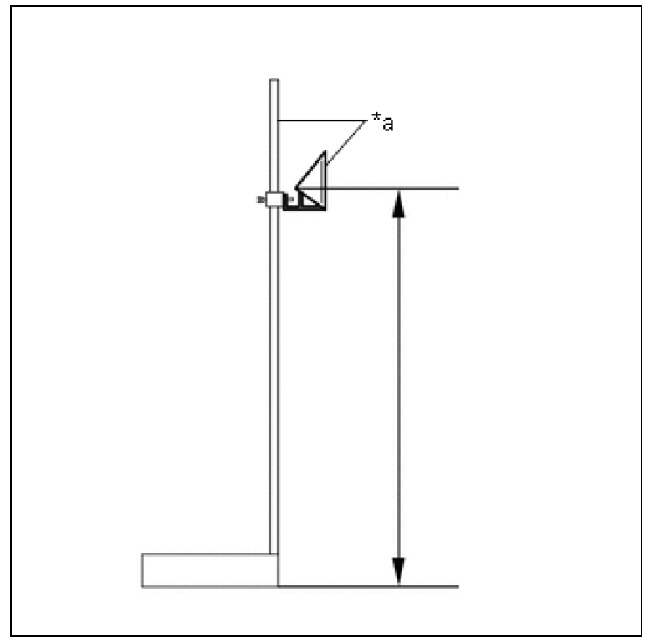

2017 Toyota Camry ACC: Reasonable Tool Cost, But 1,505 Square Feet of Open Space?
Tools Required
Space Required
Reflective Cone, Stand, Strings & Plumb Bobs
~$750
45.9 ft. Wide x 32.8 ft. (1505 Sq. Ft.) Long Clear Area in front of vehicle (No lifts, tool boxes, cars, etc.)
+ Space for the vehicle

Slide 15

Video – Honda – What not to do!

Slide 16
Q&A Session

Slide 17

Draft questions
What percentage of 2018 MY vehicles will need ADAS calibration equipment to be correctly repaired?
Today, what percentage of collision repairs correctly test and fix the ADAS hardware?
What consequences have been noted as a result of shoddy fixes?
How do dealerships currently access calibration equipment?
How do aftermarket shops currently access calibration equipment?
What does the equipment cost?
How large is the equipment?
How heavy is the equipment?
How many years and models does a set of equipment cover?
Should equipment be pooled and shared?
  How much of the market is doing this?
Should equipment be available on a rental basis?
  Are any OEMs offering programs?
Is there a better way to do this?
  What are the technical, operational, and business challenges?
How does security of vehicle software updates cause issues for the aftermarket?

